Slide 1
TORONTO

Slide 2
Machine learning at the IoT edge
SVC204
Wesley Fabella
Professional Services DevOps/IoT Consultant
Amazon Web Services

Slide 3

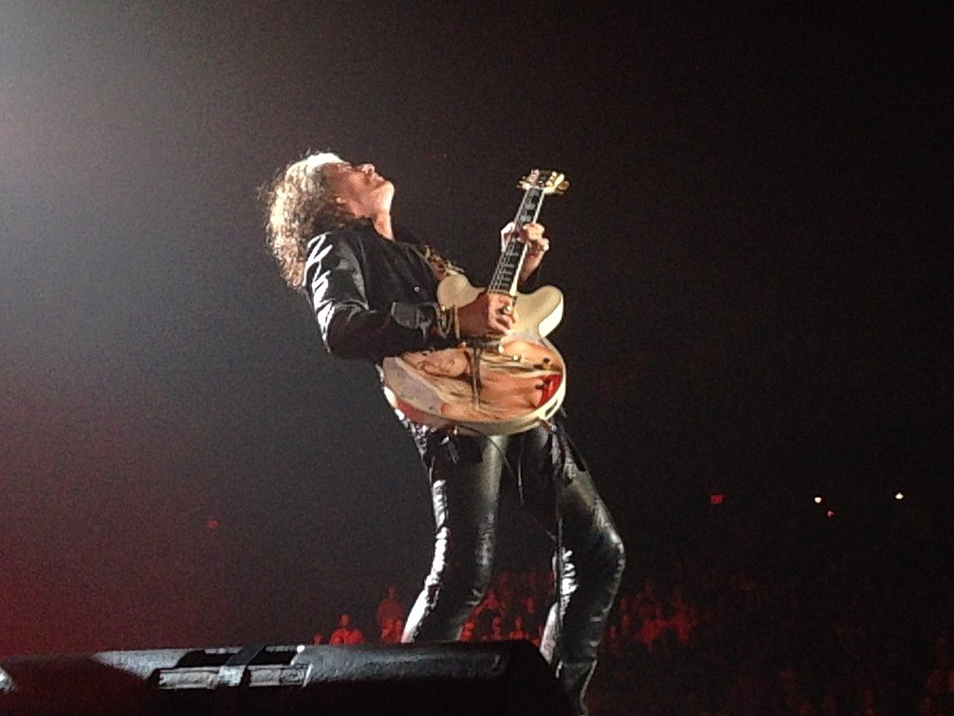
Living on the edge
Joe Perry 2015 by Abog is licensed under CC BY-SA 4.0
Notes:
Living on the edge song by Aerosmith. It’s exciting and ”edgy” song that gets the momentum going.

Slide 4












Edge: Is this new?
“A decentralized system is closer to people whom it serves, and responsive to needs…” —P. Berman, Decentralized Again, Datamation, 1970
“Whether to centralize decisions, locations and functions is a long standing debate driven by organizations…” —J. L. King, Centralized versus Decentralized Computing, 1983
AWS Cloud
Client
Camera
Car
Bicycle
Travel
Mainframe
Factory
Windfarm
Corporate data center
Notes:
Decentralized computing where computing devices were standalone and was self-sufficient. Local tape and storage drives.
Then client-server with server local storage drives.
To more centralized computing mainframes, corp data center
Truly centralized computing in managed cloud and API services.
IoT swings back to hybrid model both customer managed decentralized “Things” and centralized cloud resources.

Slide 5
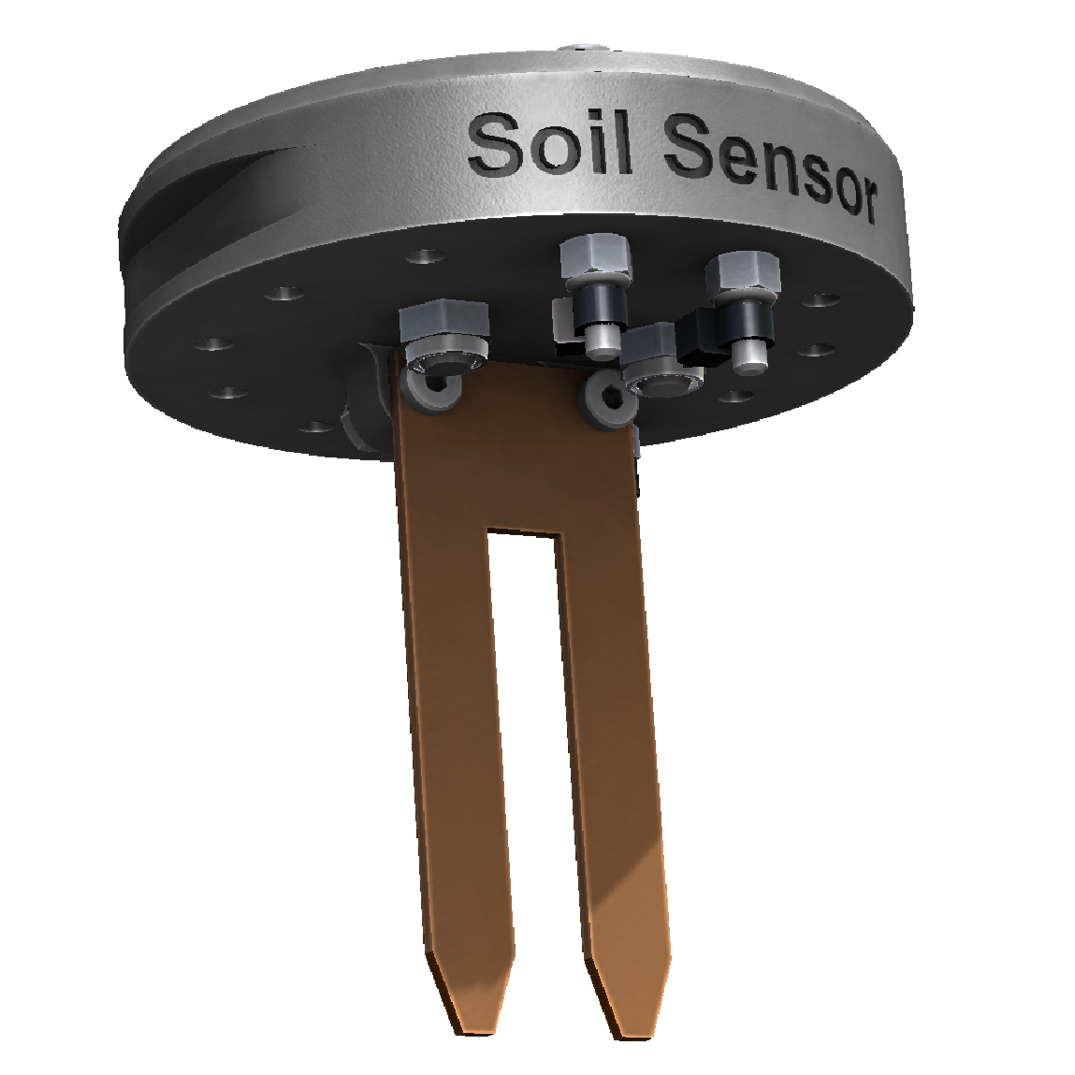
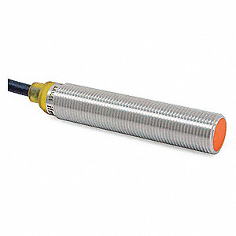
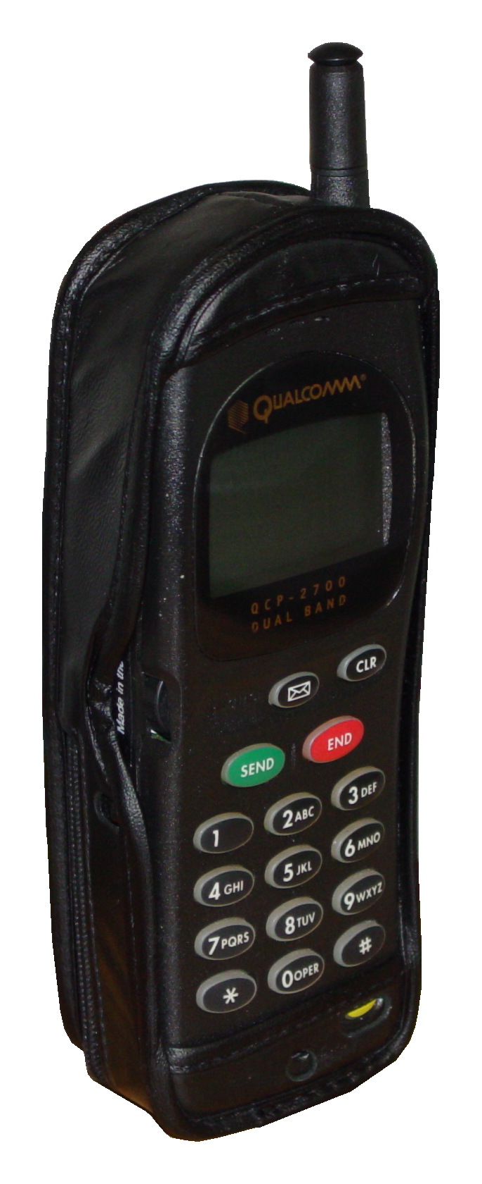

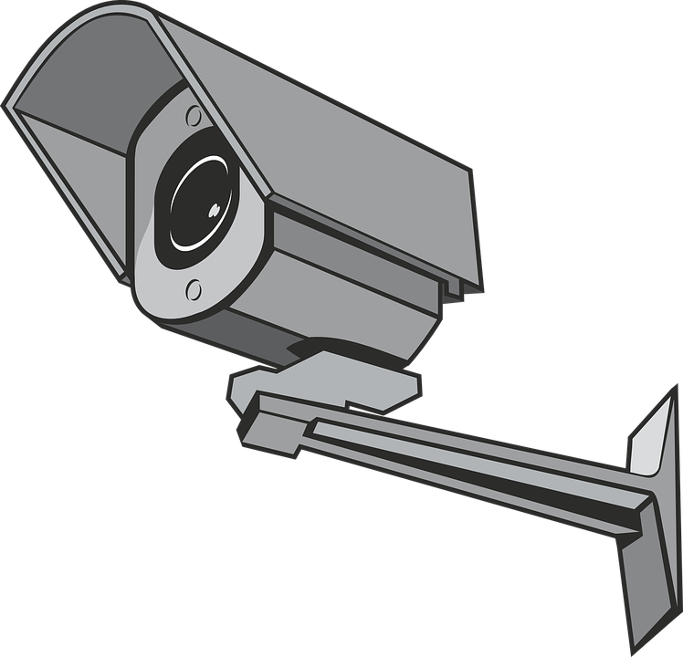
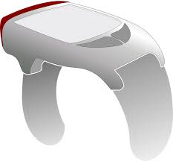
Edge: Not really a pendulum swing
At each phase:
Technology evolves – Centralized and decentralized
Bigger (by orders of magnitude) in various dimensions
Mainframes (megabyte)→ Data centers (terabyte) → Cloud (exabyte)
PCs (millions) → Mobile (billions) → Edge devices (?)
Accelerates faster each time
Notes:
Pendulum swings back to decentralized as customers want to feel a sense of “ownership” to their devices.
However scale of data today centralized data stores to collect, store, and analyze the data are needed in cloud and at the edge.
At the edge customers can have their own end of centralized data stores.

Slide 6
Agenda
Why machine learning (ML) at the edge?
Use Cases
IoT Architecture
AWS IoT Greengrass overview
Enabling ML at the edge
Demo

Slide 7
Why ML at the edge?

Slide 8

Living on the edge
Notes:
Edge: What is it?
Enables you to process data closer to where it is created.
Here are some tenets for IoT Edge, next slide..

Slide 9
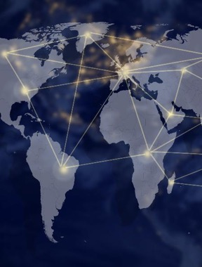


Why this problem is not going away
Law of physics
Law of economics
Law of the land
Notes:
Edge: Why do we need it?
Physics
Latency sensitive use cases: Self-Driving cars, distracted driver, manufacturing line, etc.
Does not get better with time (velocity=distance/time)
Economics
Prohibitive costs of moving mostly throw-away data.
Number of connected devices is growing
Volume of data generated per device is growing faster than any reductions transfer costs
Regulatory
Restrictions on moving data depending on use case/regulatory authorities

Slide 10
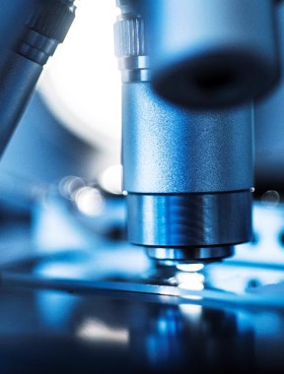
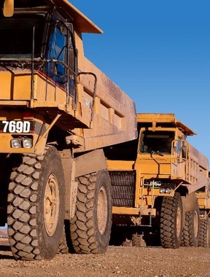

Most machine data never reaches the cloud
Medical equipment
Industrial machinery
Extreme environments
Notes:
(Optional Slide?) Additional examples – HIPPA requirements, Remote locations miles away from effective communication, and Environmental conditions including heat, humidity, other not commonly friendly to electrical equipment.

Slide 11
Use cases

Slide 12






Use cases
Self-driving cars
Smart agriculture
Predictive maintenance
Video surveillance
Robotics
!
Image recognition
Voice/sound recognition
Collision avoidance
Anomaly detection
More
Notes:
Categories applicable to ML inferencing

Slide 13








Advanced sensoring: Scenario
3. Route alert to distribution management systems
External systems (SCADA, OMS…)
Substation temp
Transformer temp
3. Build ML models
2. Real-time alert! [MQTT]
LV breaker temp
1. Anomaly detection ML
ML platform
Humidity
4. Lambda ML model
Smoke
Voltage
IIG
AWS IoT
Flood
[Modbus]
5. Lambda functions
2. Substation sensor data
Current
Ozone
Neutral current
IoT industrial gateway
Virtual data lake
AWS IoT Greengrass
Ultrasonic
Power
1. Sensor data [HTTPS]
Intrusion
Harmonics
Amazon Kinesis Data Firehose
Amazon S3
GIS, …
Environmental
sensors
Multimeters
LVM
Notes:
Example of Industry 4.0 architecture using ML inference deployed to edge

Slide 14
IoT Architecture

Slide 15
AWS IoT architecture
Things Sense and act
Cloud Storage and compute
Endpoints
Fleet onboarding, management, and software updates
Gateway
Fleet
audit and protection
IoT data analytics, actions, and intelligence
Secure device connectivity and messaging
Connecting devices to services
Gateway
Intelligence Insights and logic → Action

Slide 16
AWS IoT Greengrass overview

Slide 17








AWS IoT Greengrass
MQTT protocol
AWS IoT Core
Lambda function
AWS IoT Greengrass core
AWS IoT Greengrass
Linux, 1 GHz+, 128 MB+
OTA
AWS IoT Device Management
Notes:
Greengrass can run on variety of devices namely Rasp Pi, Intel Atom, NVIDIA Jetson, and a number of industrial devices.
Encourage you to check out device catalog.

Slide 18
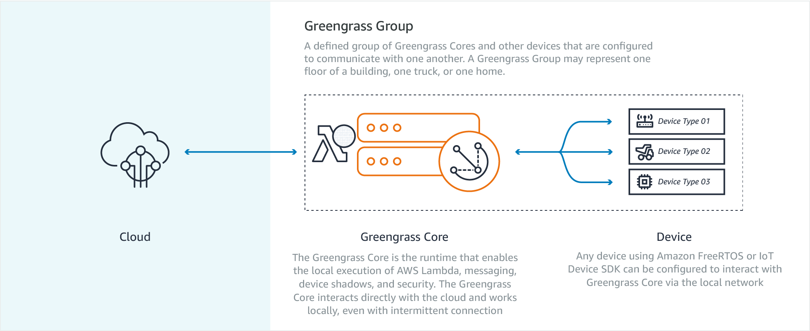
AWS IoT Greengrass
Notes:
Greengrass group has one and only one core at this time and is itself a device (or “Thing”) and is central/gateway to a collection of devices (with or even without internet access, eg. iiot assembly plant)

Slide 19
AWS IoT Greengrass
AWS IoT services
e.g., AWS IoT Core,
AWS IoT Analytics,
AWS IoT Device Defender
All AWS Cloud services
e.g., Amazon S3,
Amazon Kinesis,
Amazon Redshift
Notes:
Greengrass core is gateway @edge to integrate with many AWS Services

Slide 20




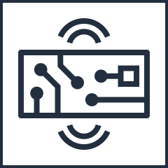




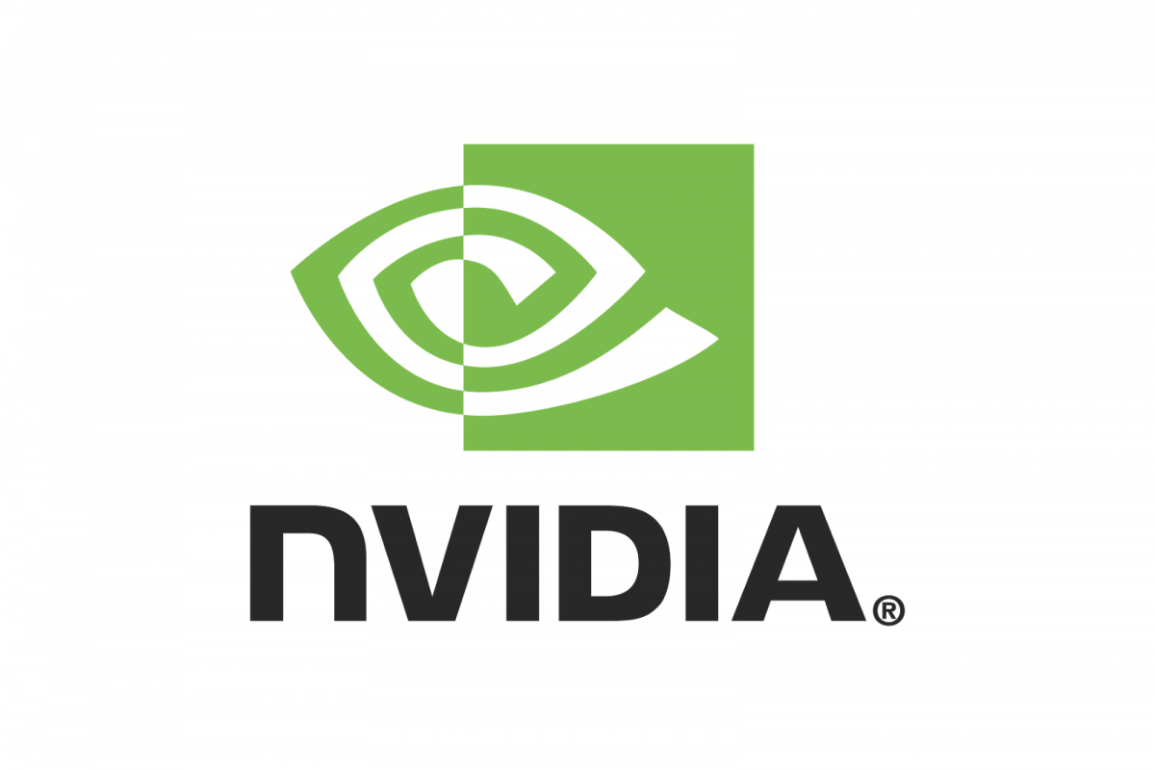

AWS IoT Greengrass connectors
What are connectors?
Connectivity to AWS services, industrial protocols, and local- and cloud-based applications
Code-free configuration and installation
10 connectors available today
Amazon Kinesis Data Firehose
Amazon Simple Notification Service
AWS IoT
Device Defender
Serial Stream
Amazon CloudWatch
Modbus RTU Protocol Adapter
Raspberry Pi GPIO
More to come in 2020
OSIsoft
Notes:
Greengrass connectors are packaged solutions that get deployed to core in Lambda function

Slide 21
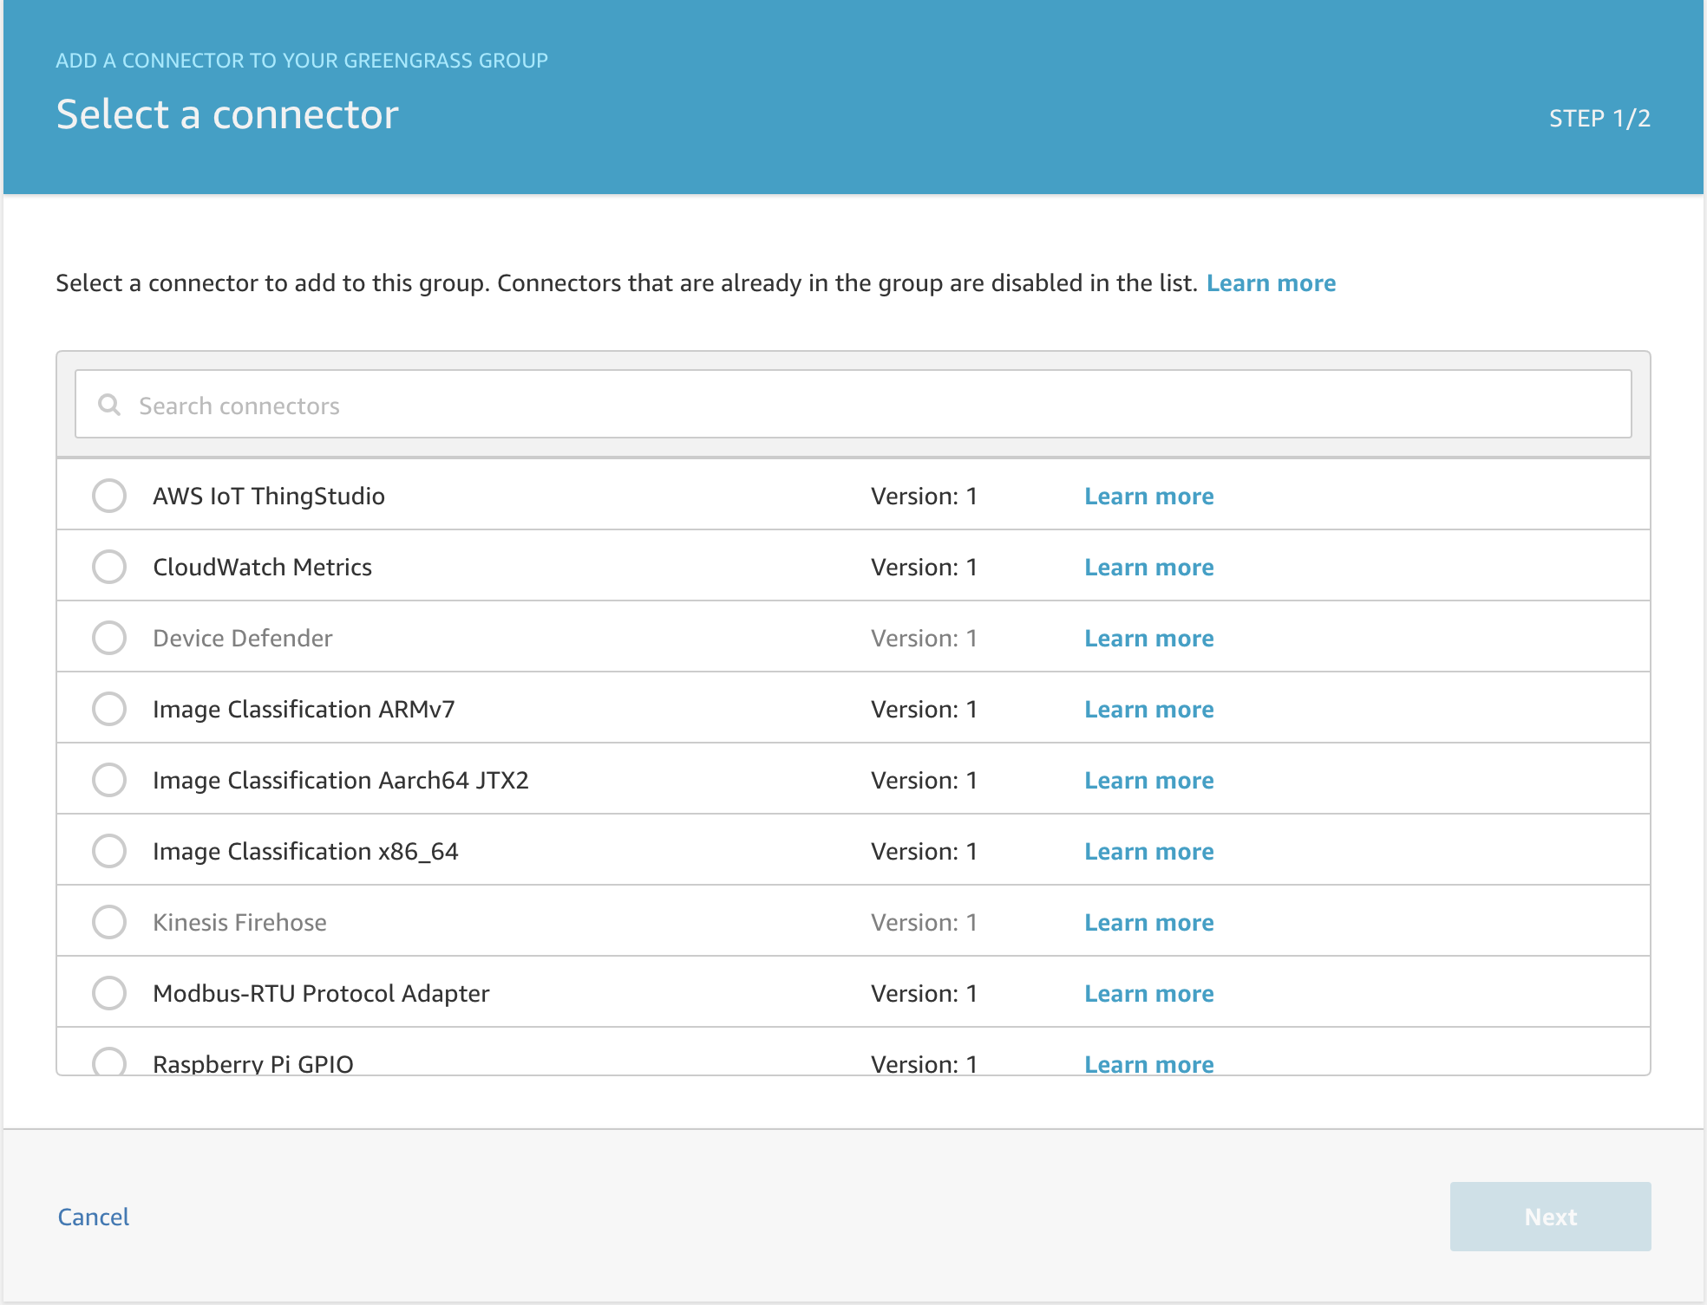
AWS IoT Greengrass connectors
Amazon Kinesis Data Firehose
Outputs data from IoT devices and AWS IoT Greengrass cores to Kinesis Data Firehose
Amazon Simple Notification Service (SNS)
Sends notifications to SNS from AWS IoT Greengrass cores based on customer logic
AWS IoT Device Defender
Integration with AWS IoT Device Defender from AWS IoT Greengrass cores
Amazon CloudWatch metrics
Sends customer-defined IoT metric data to Amazon CloudWatch
Modbus RTU Protocol Adapter
Connects to and converts Modbus protocol to MQTT messages
Raspberry Pi GPIO
Control for GPIO pins on Raspberry Pi devices running AWS IoT Greengrass
Notes:
Quick list of some of the available packaged Greengrass connectors

Slide 22
Enabling ML at the edge: AWS IoT Greengrass

Slide 23
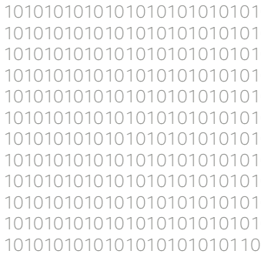
AWS IoT Greengrass: ML inference
Train models in the cloud using Amazon SageMaker or another service using Amazon EC2
ML inference works with Apache MXNet and TensorFlow
Transfer your trained models onto your AWS IoT Greengrass device to make predictions based on local data
ML inference gives you access to hardware accelerators such as GPUs on your devices
Notes:
Train models or use pre-compile models to do inferencing at edge including:
Object classification
Object detection / facial recognition
Object segmentation
Etc.

Slide 24
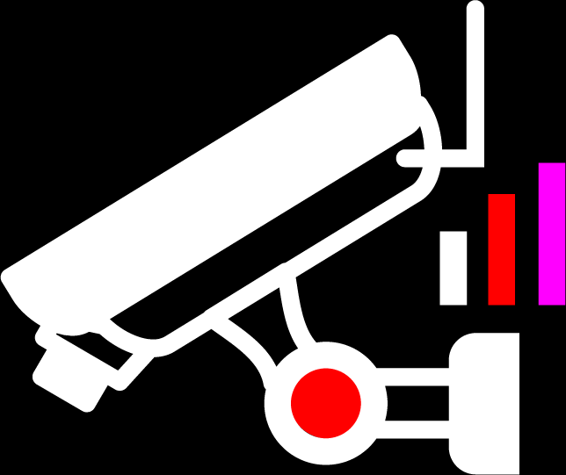
AWS IoT Greengrass: ML inference
Build and train ML models in the cloud
Use AWS IoT Greengrass to deploy optimized models on your target device
Devices take action quickly – even when disconnected
Accelerate ML inference applications on the edge
Notes:
Build and Train in cloud
Deploy to Greengrass
ML inference at Edge
Take action at the edge even when disconnected

Slide 25



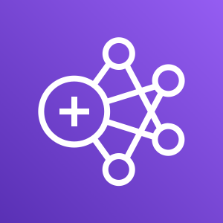






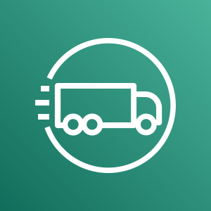



ML at the edge
Train in the cloud and infer at the edge
Data aggregation, enrichment, cleansing, time series, and model config
ML and model generation
AWS IoT Analytics
Amazon
S3
Amazon SageMaker
Ground Truth
Amazon EMR
Apache MXNet on AWS
Amazon SageMaker
AWS Deep Learning AMIs
Amazon
EC2
Intelligence and outcomes
AWS IoT Core
Amazon Kinesis
AWS Snowball
AWS Snowmobile
Amazon FreeRTOS
AWS IoT Greengrass
AWS IoT SiteWise
Bespoke
applications
Data transport and routing
Data collection and model inference
Notes:
ML at the edge is a lifecycle and collectively is rich using a number of AWS service integrations

Slide 26
Enabling ML at the edge: Feeding the data lake

Slide 27
ML at the edge
Train in the cloud and infer at the edge
Data aggregation, enrichment, cleansing, time series, and model config
ML and model generation
AWS IoT Analytics
Amazon
S3
Amazon SageMaker
Ground Truth
Amazon EMR
Apache MXNet on AWS
Amazon SageMaker
AWS Deep Learning AMIs
Amazon
EC2
Intelligence and outcomes
AWS IoT Core
Amazon Kinesis
AWS Snowball
AWS Snowmobile
Amazon FreeRTOS
AWS IoT Greengrass
AWS IoT SiteWise
Bespoke
applications
Data transport and routing
Data collection and model inference

Slide 28


In the beginning
Notes:
Data was stored in S3 bucket now with IoT data we can aggregate and store data more efficiently even utilizing storage lifecycle policies.

Slide 29







Judgment on how to bring in data
Source
Ingest point
Data lake
Notes:
IoT ingestion routes result in data lakes
One great example is by using IoT Rules to help facilitate this!

Slide 30
Enabling ML at the edge: Curating the data lake

Slide 31
ML at the edge
Train in the cloud and infer at the edge
Data aggregation, enrichment, cleansing, time series, and model config
ML and model generation
AWS IoT Analytics
Amazon
S3
Amazon SageMaker
Ground Truth
Amazon EMR
Apache MXNet on AWS
Amazon SageMaker
AWS Deep Learning AMIs
Amazon
EC2
Intelligence and outcomes
AWS IoT Core
Amazon Kinesis
AWS Snowball
AWS Snowmobile
Amazon FreeRTOS
AWS IoT Greengrass
AWS IoT SiteWise
Bespoke
applications
Data transport and routing
Data collection and model inference
Notes:
Once data ingested (collected) is in the data lake how can we build ML models?

Slide 32
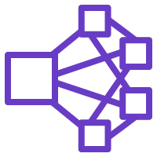
Ingesting and methodically curating
Notes:
ETL may need to be done to form fit the data based on specific use case and business outcomes/objectives

Slide 33


Iteratively evaluating and refining: Where data science meets art
Annotation
Cleansing
Re-process raw data
Data types
Does the data properly drive intended results?
Notes:
Iterative process, data munging and engineering in order to tweak specific models
SageMaker Neo can optimize edge models for Greengrass

Slide 34
Enabling ML at the edge: Model training and staging

Slide 35
ML at the edge
Train in the cloud and infer at the edge
Data aggregation, enrichment, cleansing, time series, and model config
ML and model generation
AWS IoT Analytics
Amazon
S3
Amazon SageMaker
Ground Truth
Amazon EMR
Apache MXNet on AWS
Amazon SageMaker
AWS Deep Learning AMIs
Amazon
EC2
Intelligence and outcomes
AWS IoT Core
Amazon Kinesis
AWS Snowball
AWS Snowmobile
Amazon FreeRTOS
AWS IoT Greengrass
AWS IoT SiteWise
Bespoke
applications
Data transport and routing
Data collection and model inference
Notes:
Train and Build models in cloud once data has been curated to meet business outcomes

Slide 36




ML at the edge
Train in the cloud and infer at the edge
Amazon SageMaker
ML services
Ground Truth
Notebooks
Algorithms + AWS Marketplace
RL
Training
Optimization
Deployment
Hosting
ML frameworks + infrastructure
P3
P3dn
C5
C5n
Elastic Inference
AWS Inferentia
AWS IoT Greengrass
Frameworks
Interfaces
Infrastructure
Notes:
SageMaker capabilities to train and build models in cloud using variety of ML frameworks and infrastructure

Slide 37
Enabling ML at the edge: Inferring at the edge

Slide 38
ML at the edge
Train in the cloud and infer at the edge
Data aggregation, enrichment, cleansing, time series, and model config
ML and model generation
AWS IoT Analytics
Amazon
S3
Amazon SageMaker
Ground Truth
Amazon EMR
Apache MXNet on AWS
Amazon SageMaker
AWS Deep Learning AMIs
Amazon
EC2
Intelligence and outcomes
AWS IoT Core
Amazon Kinesis
AWS Snowball
AWS Snowmobile
Amazon FreeRTOS
AWS IoT Greengrass
AWS IoT SiteWise
Bespoke
applications
Data transport and routing
Data collection and model inference

Slide 39
Demo

Slide 40

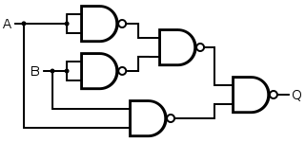

Device-level dependencies
/dev/vcsm
/dev/vhciq
PL
AWS IoT Greengrass
/dev/video0
greengrassObjectClassification
PS
m2m
Notes:
Greengrass support for local resources including Pi Camera, Webcams, PLCs, etc.
VCSM /* VideoCore Shared Memory - user interface library.**** This library provides all the necessary abstraction for any application to** make use of the shared memory service which is distributed across a kernel** driver and a videocore service.
VCHIQ is a command interface between the running Linux kernel and peripherals (among other things) in the VideoCore silicon. /dev/vhciq provides generic userspace access to those commands for use by (at minimum) the camera and audio subsystems as well. It's a decently dangerous interface to expose to random programs, hence the somewhat restrictive permissions by default.

Slide 41
Recap

Slide 42
Recap
Data aggregation, enrichment, cleansing, time series, and model config
ML and model generation
AWS IoT Analytics
Amazon
S3
Amazon SageMaker
Ground Truth
Amazon EMR
Apache MXNet on AWS
Amazon SageMaker
AWS Deep Learning AMIs
Amazon
EC2
Intelligence and outcomes
AWS IoT Core
Amazon Kinesis
AWS Snowball
AWS Snowmobile
Amazon FreeRTOS
AWS IoT Greengrass
AWS IoT SiteWise
Bespoke
applications
Data transport and routing
Data collection and model inference
Notes:
ML lifecycle is cyclical and improves through iteration
AWS service integrations support ML and inferencing at IoT Edge!

Slide 43
Wesley Fabella
https://github.com/elviento/
https://www.linkedin.com/in/wesleyfabella/
https://twitter.com/wezjf

